Slide 1

Testbed Automation for Network Security and Security Analytics
Aragats Amirkhanyan
Internet-Technologies and Systems
Hasso Plattner Institute

Slide 2
Motivation
Common issues for research in network security and security analytics areas:
The absence of data
Test network environment
Testbed

Slide 3
Agenda
Motivation
A testbed for preparing data to analytics
Architecture
User behavior - Normal scenario
User behavior - Abnormal scenario
Implementation
Conclusion

Slide 4
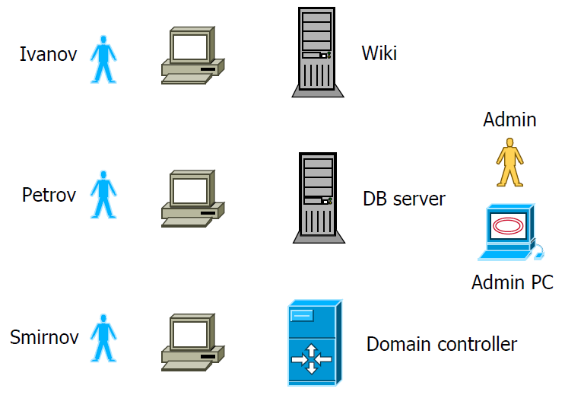
A testbed for preparing data to analytics - Architecture
Description of the network:
4 client computers
Domain controller
Wiki server
Database server
Users:
Ivanov
Petrov
Smirnov
Admin

Slide 5
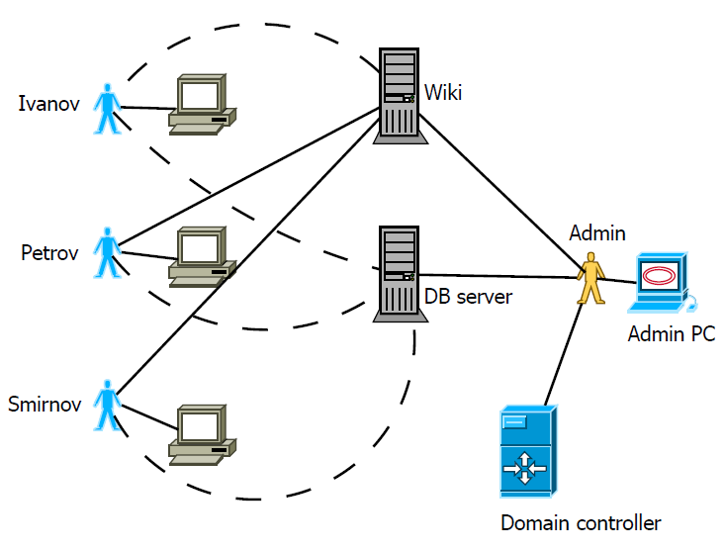
User behavior - Normal scenario

Slide 6
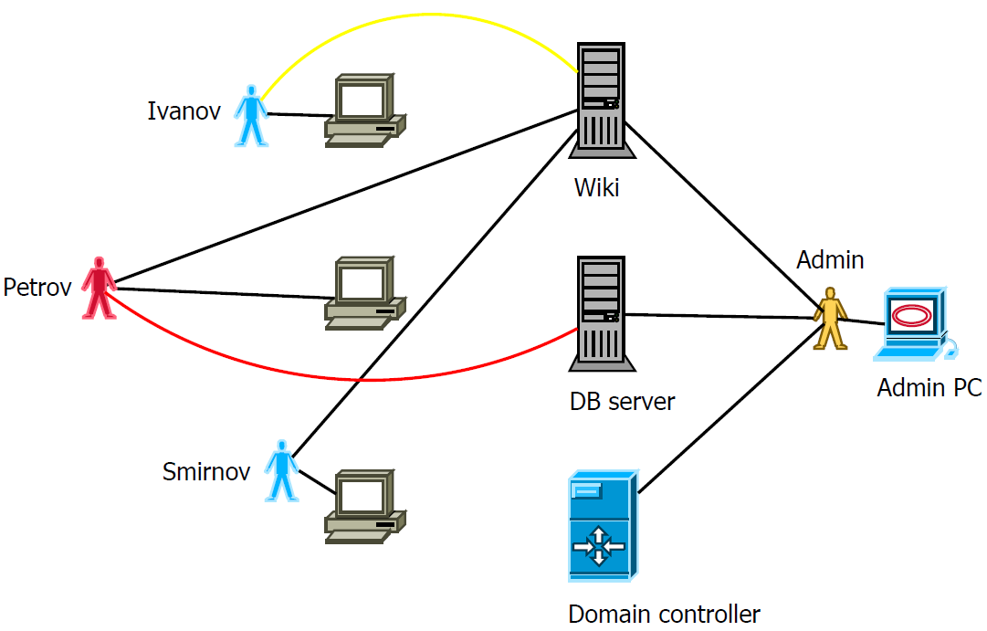
User behavior - Normal scenario

Slide 7
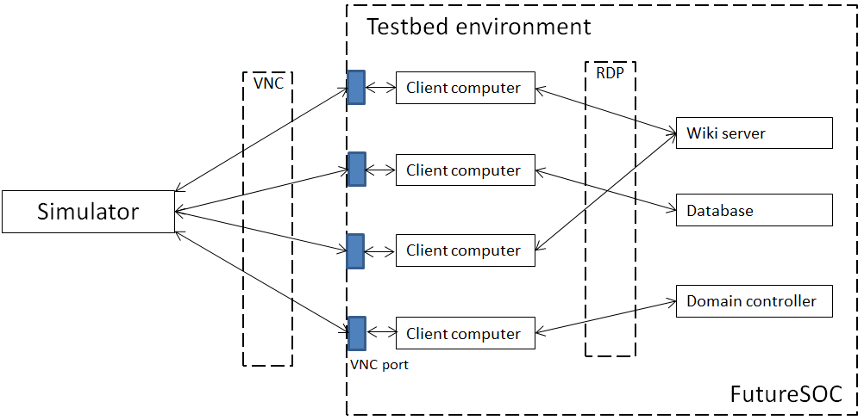
User behavior - Implementation

Slide 8
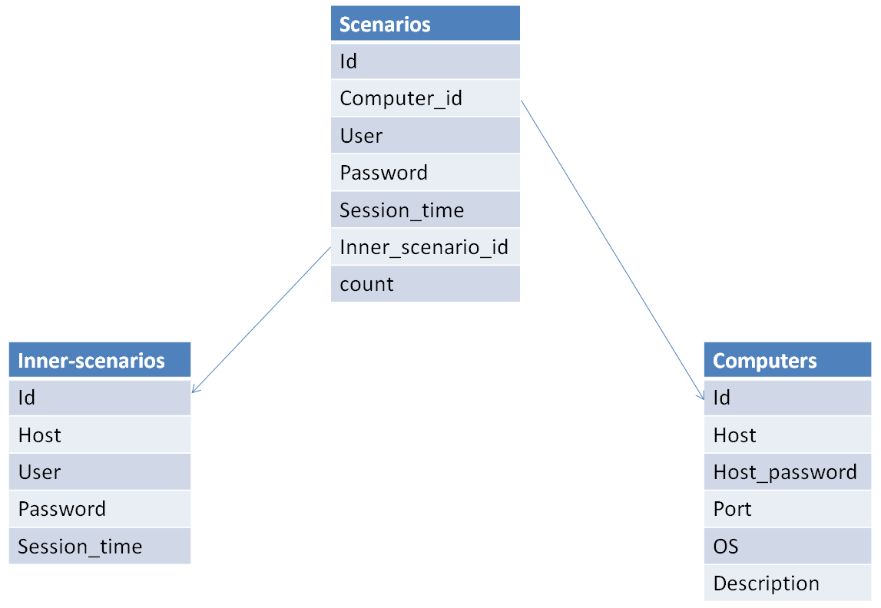
User behavior - Implementation
FutureSOC ESXi server
VNC protocol
Python programming language
Vncdotool library
CSV

Slide 9
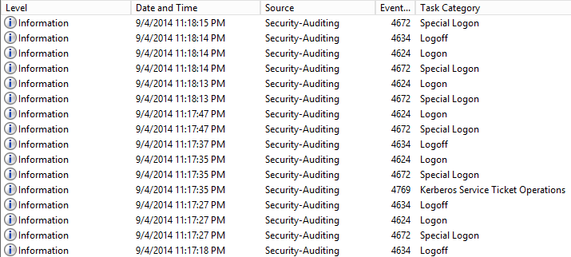
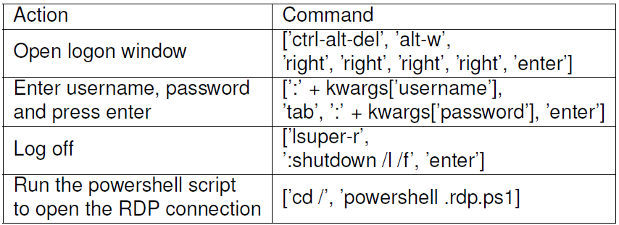

Slide 10
Conclusion and Future Work
Experiment simulation with the test network of enterprise or campus level
Experiment simulation with large amount of users
Experiment simulation with random user behavior

Slide 11
Thank you for your attention!
Aragats Amirkhanyan
Internet-Technologies and Systems
Hasso Plattner Institute

Slide 12


Slide 13


Slide 14


Slide 15
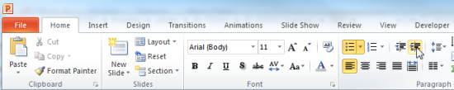
Explanations - Text layers
First text layer for running text.
Second level for bullet points
Third level for bullet points
Fourth level for bullet points
Fifth level for numberings
Sixth level for listings
Seventh text layer for Core Messages
In this template, we pre-formatted different text layers (as you can see on the right side). You don’t have to generate bullet points manually. By the way: Please avoid this!
To change from one text layer to the next, use the Increase / Decrease List Level buttons:

Slide 16
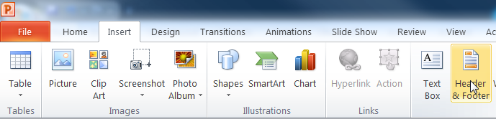
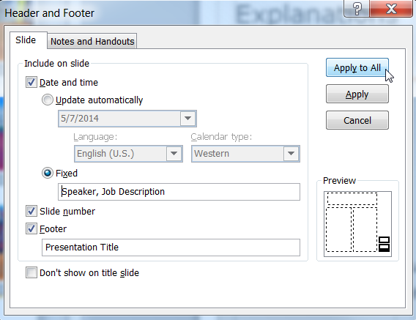
Explanations - Footer
You can insert or change your presentation‘s footer. Click on the Insert-tab | Header and Footer | After filling in your descriptions click on Apply to All.
Descriptions:
Activate date and time and write in:Speaker, Job Description
Activate the slide number.
Activate the footer and write in: Presentation Title
Don‘t use the template without the complete footer.

Slide 17
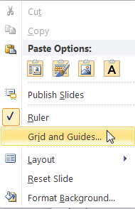
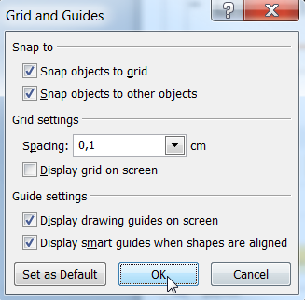
Explanations - Drawing guides
You can enable your guide-lines to align objects on the slide (View | Show | Select the option „Guides“)
Or hit the right mouse button outside the slide and go at „Grid and Guides…“

Slide 18
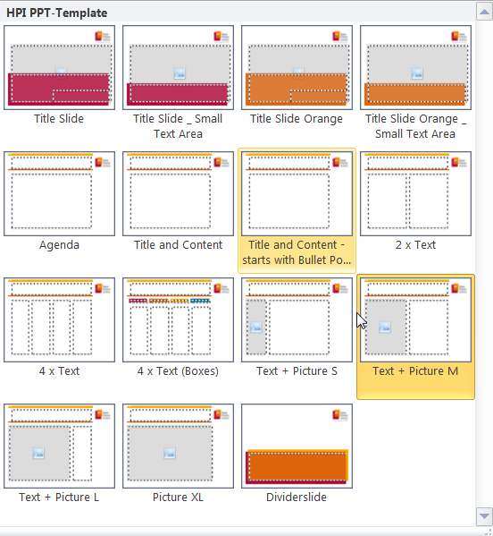
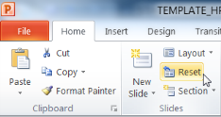
Explanations - Slide layouts
You can choose between different slide layouts. These pre-defined layouts gives you the oportunity to use text and visualisations just the right way.
To use these layouts:
Click on the Home-tab | New Slide or Layout | and choose one out of the layouts
Click „Reset“ to reset to the predefined slide layout.

